Slide 1
Class & objects

Slide 2
Object and Classes
Since Java is an object oriented language, complete java language is build on classes and object. Java is also known as a strong Object oriented programming language(OOPS).
OOPS is a programming approach which provides solution to problems with the help of algorithms based on real world. It uses real world approach to solve a problem. So object oriented technique offers better and easy way to write program then procedural programming model such as C, ALGOL, PASCAL.

Slide 3
Class
In Java everything is encapsulated under classes. Class is the core of Java language. Class can be defined as a template/ blueprint that describe the behaviors /states of a particular entity. A class defines new data type. Once defined this new type can be used to create object of that type. Object is an instance of class. You may also call it as physical existence of a logical template class.
A class is declared using class keyword. A class contain both data and code that operate on that data. The data or variables defined within a class are called instance variables and the code that operates on this data is known as methods. Thus, the instance variables and methods are known as class members. class is also known as a user defined datatype.
A class and an object can be related as follows: Consider an ice tray(like of cube shape) as a class. Then ice cubes can be considered as the objects which is a blueprint of its class i.e of ice tray.

Slide 4
Rules for Java Class
A class can have only public or default(no modifier) access specifier.
It can be either abstract, final or concrete (normal class).
It must have the class keyword, and class must be followed by a legal identifier.
It may optionally extend one parent class. By default, it will extend java.lang.Object.
It may optionally implement any number of comma-separated interfaces.
The class's variables and methods are declared within a set of curly braces {}.
Each .java source file may contain only one public class. A source file may contain any number of default visible classes.
Finally, the source file name must match the public class name and it must have a .java suffix.

Slide 5
A simple class example
Suppose, Student is a class and student's name, roll number, age will be its property. Lets see this in Java syntax
class Student.
{
String name;
int rollno;
int age;
}

Slide 6
Reference
When a reference is made to a particular student with its property then it becomes an object, physical existence of Student class.
Student std=new Student();
The above statement std is instance/object of Student class. Here the new keyword creates an actual physical copy of the object and assign it to the std variable. It will have physical existence and get memory in heap area. The new operator dynamically allocates memory for an object

Slide 7
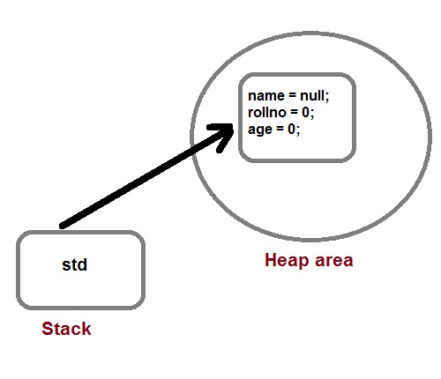

Slide 8
How a class is initialized in java?
A Class is initialized in Java when an instance of class is created using either new operator or using reflection using class.forName().
A class is also said to be initialized when a static method of Class is invoked or a static field of Class is assigned.

Slide 9
How would you make a copy of an entire Java object with its state?
Make that class implement Cloneable interface and call clone() method on its object.
clone() method is defined in Object class which is parent of all java class by default.

Slide 10
Object class in Java
The Object class is the parent class of all the classes in java by default. In other words, it is the topmost class of java.
The Object class is beneficial if you want to refer any object whose type you don't know. Notice that parent class reference variable can refer the child class object, know as upcasting.
Let's take an example, there is getObject() method that returns an object but it can be of any type like Employee, Student etc, we can use Object class reference to refer that object.

Slide 11
Ways to create object of a class
There are four ways to create objects in java. Strictly speaking there is only one way(by using new keyword),and the rest internally use new keyword.
By new keyword
By newInstance() method
By clone() method
By deserialization

Slide 12
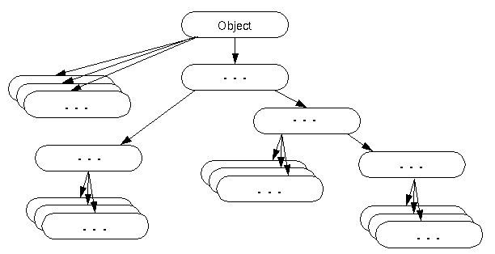
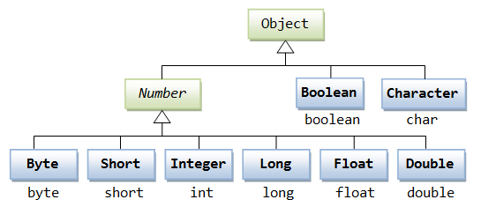
For example:
Object obj=getObject();//we don't know what object will be returned from this method
The Object class provides some common behaviors to all the objects such as object can be compared, object can be cloned, object can be notified etc.

Slide 13
Method | Description
public final Class getClass() | returns the Class class object of this object. The Class class can further be used to get the metadata of this class.
public int hashCode() | returns the hashcode number for this object.
public boolean equals(Object obj) | compares the given object to this object.
protected Object clone() throws CloneNotSupportedException | creates and returns the exact copy (clone) of this object.

Slide 14
Methods in Java
Method describe behavior of an object. A method is a collection of statements that are group together to perform an operation.
Syntax :
return-type methodName(parameter-list)
{
//body of method
}
Advantage of Method
Code Reusability
Code Optimization

Slide 15
Example of a Method
public String getName(String st)
{
String name="StudyTonight";
name=name+st;
return name;
}

Slide 16
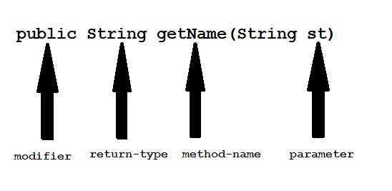

Slide 17
Modifier : Modifier are access type of method. We will discuss it in detail later.
Return Type : A method may return value. Data type of value return by a method is declare in method heading.
Method name : Actual name of the method.
Parameter : Value passed to a method.
Method body : collection of statement that defines what method does.

Slide 18
Parameter Vs. Argument
While talking about method, it is important to know the difference between two terms parameter and argument.
Parameter is variable defined by a method that receives value when the method is called. Parameter are always local to the method they dont have scope outside the method. While argument is a value that is passed to a method when it is called.

Slide 19
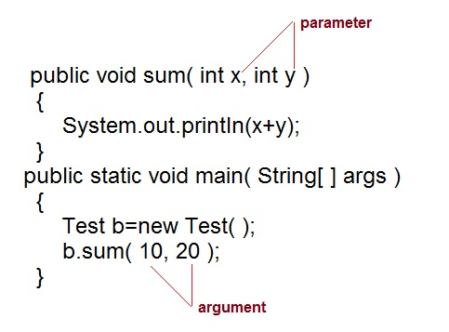

Slide 20
call-by-value and call-by-reference
There are two ways to pass an argument to a method:
call-by-value: In this approach copy of an argument value is pass to a method. Changes made to the argument value inside the method will have no effect on the arguments.
call-by-reference: In this reference of an argument is passed to a method. Any changes made inside the method will affect the argument value.
NOTE :There is only call by value in java, not call by reference.

Slide 21
Example of call-by-value
public class Test
{
public void callByValue(int x)
{
x=100;
}
public static void main(String[] args)
{
int x=50;
Test t = new Test(); t.callByValue(x);
//function call System.out.println(x);
}
}

Slide 22
Method overloading
If two or more method in a class have same name but different parameters, it is known as method overloading. Overloading always occur in the same class(unlike method overriding).
Method overloading is one of the ways through which java supports polymorphism. Method overloading can be done by changing number of arguments or by changing the data type of arguments. If two or more method have same name and same parameter list but differs in return type are not said to be overloaded method
Note: Overloaded method can have different access modifiers.

Slide 23
Different ways of Method overloading
There are two different ways of method overloading
Method overloading by changing data type of arguments.
Method overloading by changing number of arguments.
Advantage of method overloading
Method overloading increases the readability of the program.

Slide 24
Method overloading by changing data type of Arguments
class Calculate
{
void sum (int a, int b)
{
System.out.println("sum is"+(a+b)) ;
}
void sum (float a, float b)
{
System.out.println("sum is"+(a+b));
}x
Public static void main (String[] args)
{
Calculate cal = new Calculate();
cal.sum (8,5);
//sum(int a, int b) is method is called. cal.sum (4.6f, 3.8f);
//sum(float a, float b) is called.
} }
Output :: Sum is 13 Sum is 8.4

Slide 25
Method overloading by changing number of arguments
class Area
{
void find(int l, int b)
{
System.out.println("Area is"+(l*b)) ;
}
void find(int l, int b,int h)
{
System.out.println("Area is"+(l*b*h));
}
public static void main (String[] args)
{
Area ar = new Area(); ar.find(8,5);
//find(int l, int b) is method is called.
ar.find(4,6,2);
//find(int l, int b,int h) is called.
}
}
Output :: Area is 40 Area is 48

Slide 26
Interview questions
Can a top-level class be private or protected?
Differentiate between a Class and an Object?
What is a singleton class?
Or
What is singleton pattern?
If a class is declared without any access modifiers, where may the class be accessed?
What is the purpose of the Runtime class?
What is the purpose of the System class?
What is the functionality of instanceOf() ?

Slide 27
End of Session - 6 Thank You !

